Slide 1
Polarity Analysis
Module 4
Neurology
Heiner Frei

Slide 2
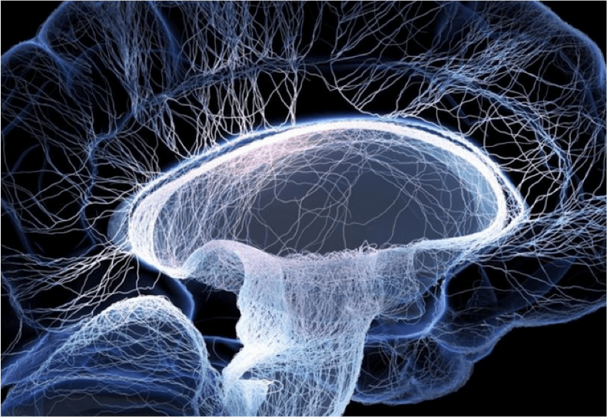
Contents
The neurologically conspicuous infant
Epilepsy
Muscle Dystrophy Type Duchenne
Whip lash injury
Ataxic-dyskinetic cerebellar disease
Konversion syndrome
Carpal tunnel syndrome
Trigeminus neuralgia
Exercise cases (Script)

Slide 3
The Neurologically Conspicuous Infant
Symptoms
Cries frequently, sometimes for hours
High pitched crying
Muscle tone too low/too high
Asymmetries of body
Atypical movements (hyperextension, athethoid, ataxic)
Delayed psychomotor development
Feeding problems
Sleep disorders
Epilepsy

Slide 4
Case 1: Delayed Psychomotor Development
Brians parents both have an ADHD. The mother was never treated, while the father had methylphenidate as a child.
Brian is their first child. He was born in the 37th week of pregnancy by caesarean section due to a transverse position. The neonatal adaptation was normal (Apgar score 8/9/9).

Slide 5
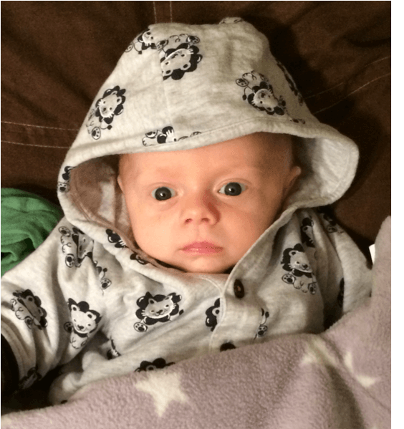
The firsts two months of his life Brian sleeps during the day, and cries almost all night. He drinks greedily, has quickly enough and is as quickly hungry again.
His pediatrician diagnoses baby-colics and prescribes Flatulex, which has no effect.

Slide 6
After two months he also begins to cry, as soon as he is not carried around.
With five months the parents try to introduce solid food, and he begins to ruminate: keeps the food in his mouth like a hamster for a long time and then regurgitates it.
The pediatricians comment is that he only needs tender loving care; later on one could give him methylphenidate.
And the parents increasingly reach their limit with carrying him around. Finally, with seven months, they come into our practice.

Slide 7
PM-Development at 7 Months
Smiling with 10 weeks,
Grasping objects with 5 months.
Refuses solid food, since 5th month.
Choking when getting solid food, only wants breastfeeding.
Disturbed day-nigth rhythm, cries all night.
Cries frequently also during the day
Does not sit yet

Slide 8
Examination with 7 Months
Restless, cring infant, calms down when taking off clothes.
Weight P. 10 (at birth P. 50), length and head circumference P. 50.
Extreme flabbyness of muscles, insufficient head control.
Does not sit alone.
Astasia.
Hyperextension of body with shoulder retraction.
Oral hypersensitivity with choking as soon as something touches palate.

Slide 9
Diagnoses
Severe muscle hypotonia and ataxia of trunc
Perception disorders
Delayed psychomotor development
Oral hypersensitivity
Sleep disorder
Failure to thrive (weight gain too low for age)
Procedure
Determination of homeopathic remedy
Handling instruction
Oral desensitation

Slide 10
Checkliste for Perception Disorders
High reliability
Low reliability
< Warmth
> Uncovering
< After sleep, upon awaking
< When going to sleep
Irritability
Intermediate reliability
> Movement (Carrying around)
< Alone
< Darkness
< Lack of sleep
> in open air (Carrying around?)
> Physical efforf (?)

Slide 11
Repertorisation - Procedure
We only use the symptoms of high and intermediate reliability, and leave the ones of low reliability away.
In addition we use the findings of our examination, and symptoms not mentioned on the checklist.
  < Pressure of clothes
  Sadness
  Muscles flabby
  Emaciation
  < Eating during

Slide 12


Slide 13
Interpretation
6 Remedies cover all symptoms, but four of them have contraindications.
Lycopodium and Calcium carbonicum are the favorites.
The problems of digestion and an early dentition rather speak for Lycopodium.
Brian does not sweat, is not overweight and does not have the doughy skin often seen in Calcium patients.

Slide 14
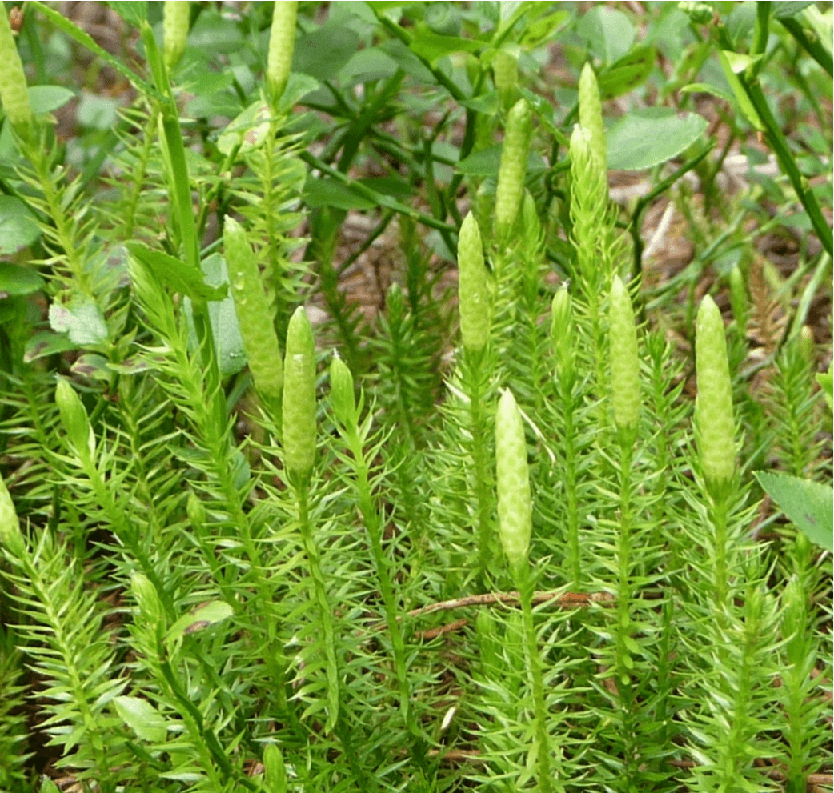

Slide 15
Remedy and Progress
He receives one dose of Lycopodium C 200.
Within a few days he calms down and begins to sleep several laps of 90 minutes at night.
With further doses of Lycopodium (M, XM LM, CM) he gets more and more relaxed and content and makes a thrust in his development. His weight recovers and reaches again the 50th percentile.

Slide 16
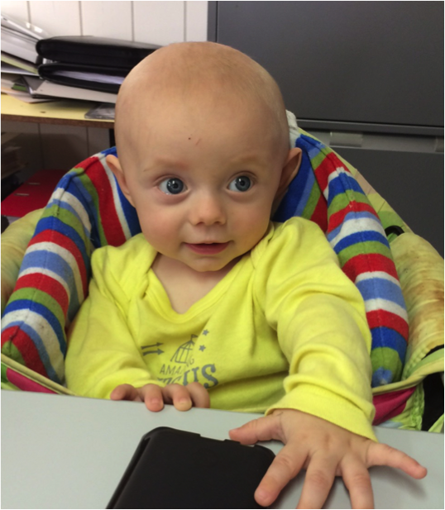
Further Progress
But with 9 months he still does not sit alone, and the oral hyper-sensitivity persists. We begin with a Bobath treatment.
Since the duration of action of the singele doses is only two weeks, we change to daily doses of Lycopodium C 200, later, M and then XM, etc..
In the long run all the pecularities disappear and he becomes a normal infant.

Slide 17
Comment
Remedy determination in infants is scout-work. Very often the parents can only report a few symptoms. It is therefore important to include the doctors own observations.
Lycopodium has changed the life of this patient. With the additional Bobath treatment he reached a normal psychomotor development state.
The dosage must be adapted to the individual requirements. Sometimes it has to be unconventional, as in this case

Slide 18
Epilepsies – Classification 2009
Generalised attacks
Tonic-clonic epilepsy
Absences
Myoclonic epilepsy
Klonic epilepsy
Tonic eepilepsy
Atonic epilepsy
Focal attacks
Unknown forms
Epileptic spasms

Slide 19
Homeopathy in Epilepsy
For homeopathic remedy determination there is a recommendation to use the interval symptoms, not the ones of the attack.
We include in our cases one of the following epilepsy descriptions anyway.
Epilepsy
Epilepsy with conciousness
Epilepsy without conciousness
Epilepsy with convulsions
Epilepsy with rigidity
Cramps with opistotonus

Slide 20
Case 2: Lennox Syndrome
Mara is born in the 39th week of pregnancy by an emergency caesarean section due to a HELP syndrome of the mother. The neonatal adaptation was normal.
At the age of 11 months she begins to have epileptic attacks every day, with a staring look, then she spreads her arms out as for a Salaam greeting, then nods her head up to 20 times. During the attacks she is concious, and after them normal as before.

Slide 21
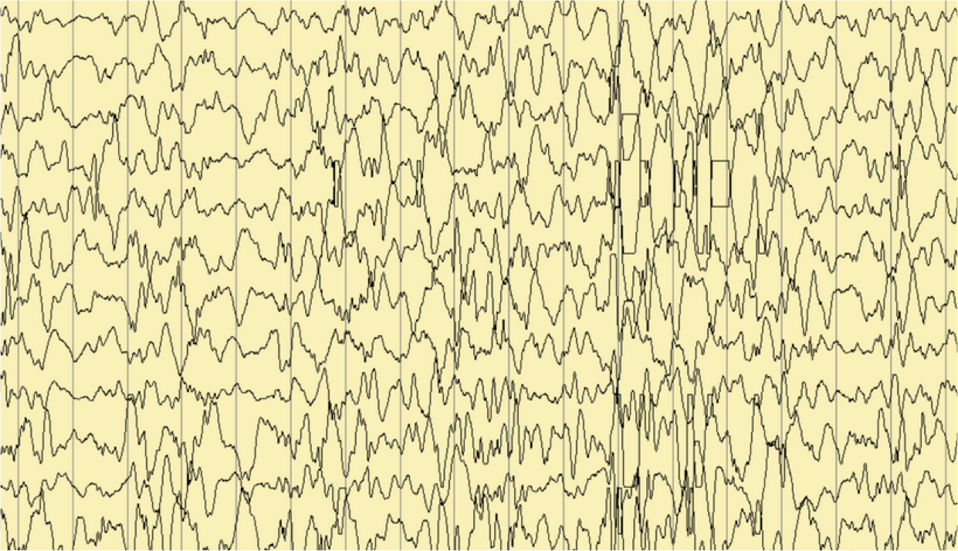
Hypsarrhythmia in WEST-Syndrome

Slide 22
The treatment with Depakine has no effect. She begins to fall back in her psychomotor development, and a healing paedagogic training is started.
Despite six other antiepileptic medicines the child develops additional Grand Mal attacks with tonic and clonic seizures and the loss of conciousness.

Slide 23
I see her first at the age of three because all antiepileptic treatments so far had failed (Depakine, Sabril, Rivotril, Tegretol, Lamictal, ACTH-Cure and Felbamate). Under Felbamate she still has three Grand Mal atacks per day.
The recent EEG showed an intermittant delta-focus in the left fronto-temporal region, and a beta-discharge of a few seconds duration with cinical correlate.

Slide 24
Examination with 3 Years
Very trustful, friendly child, who constantly talks.
Motor Restlessness.
Tic-like blinking.
Small whart on tip of nose.
Psychomotor development corresponding to a 2 year old.

Slide 25
Checklist
Epilepsy with conciousness (West-syndrome)
Epilepsy without conciousness (Grand Mal)
< Upon awaking
< Eating, while
< Cold
> Wrapping up warmly
Understanding difficult
Irritability
Sadness
Muscles tense
Tic’s
Talkativeness

Slide 26


Slide 27
Interpretation
Only Sepia and Belladonna cover all symptoms. If we include the symptom talkativeness (Kent repertory) only Belladonna remains.

Slide 28
Materia medica-Comparison for Belladonna (GS)
Restlessness, Talkativeness.
Epileptic convulsions
Cramps, twitching, convulsions of limbs, with distorsion of limbs and eyes. After convulsions deep sleep.

Slide 29
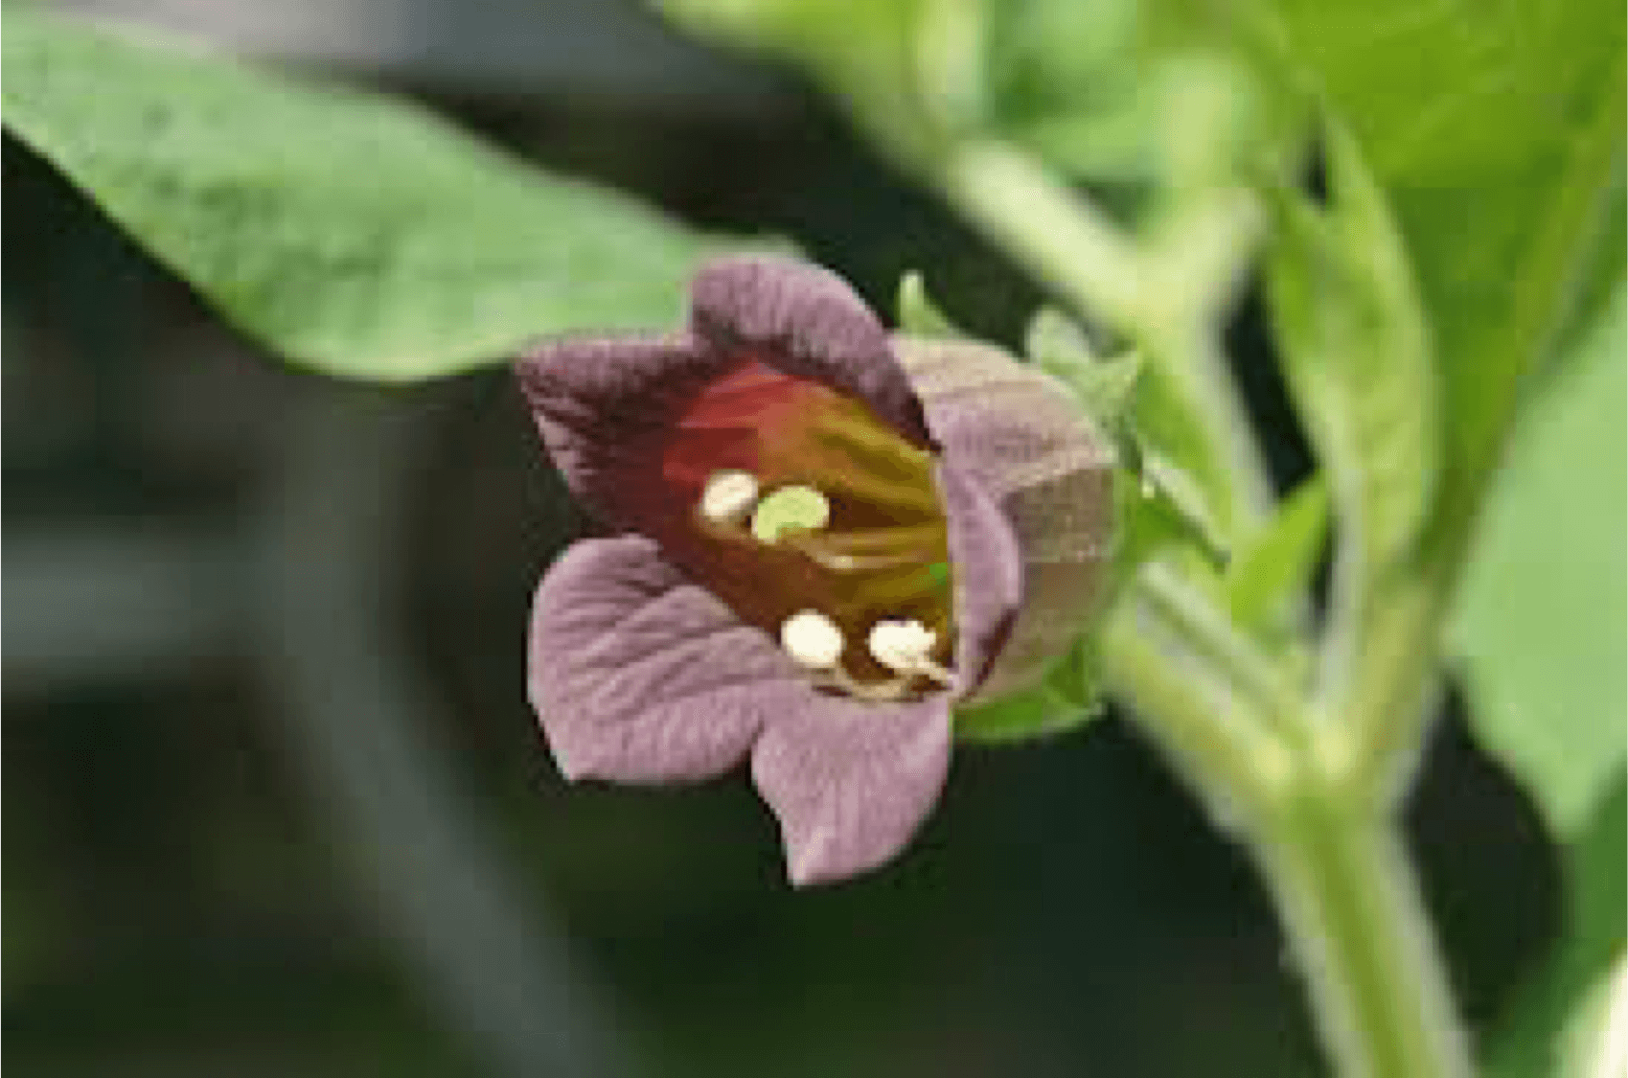

Slide 30
Mittelgabe und Verlauf
Mara receives a dose of Belladonna C 200.
During the following two weeks she has up to six attacks every day, afterwards their frequenca decreases. Last attack six weeks after the remedy.
She makes psychomotor progress now, speaks understandably, can climb stairs, and begins to dress herself without help.
And in healing paedagogic training she cooperates better.

Slide 31
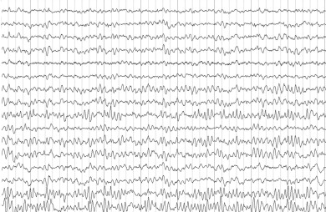
The next EEG after 10 weeks is normal

Slide 32
Further Progress
The neurologists call it a «spontaneous cure» and begin to taper off anticonvulsive treatment.
We do not repeat Belladonna. Mara has no further epileptic attacks until the age of 15 years.
Then she begins to have Grand Mal attacks again, who do not respond to homeopathy. Conventional treatment reduces their frequency, but does not prevent them alltogether.

Slide 33
Comment
His child is good for surprises:
1. The disappearance of the epilepsy with 2 globules of Belladonna, after seven conventional antiepileptics without effect.
2. The continuous effect of Belladonna over 12 years.
3. The resitance to any treatment after the relapse.
We wonder how well epileptic disease are understood at all.

Slide 34
Case 3: Muscular Dystrophy, Complications
17-year old Leon suffers since early childhood of a progressive muscular dystrophy, type Duchenne. Since the age of seven he is dependant on a wheelchair.
Clinical picture
Begin between 2-6 years
Waddling
Hyperlordosis
Pseudohypertrophy of the calves
Gower-sign
Early dependancy on wheelchair
Genetics: X-chromosomal-recessiv, 50% spontaneous mutations
Diagnosis: CPK elevated, typ. EMG
Prognose: 75% mortality before age 20

Slide 35
Gower sign

Slide 36
Past history:
Sepia and later Lycopodium helped to protect him from frequent respiratory tract infections. He went rather well up to now.
Actual Problems:
Since one year increasing frequency of respiratory tract infections
Headaches at night
Inability to sleep.
Urge to defecate upon awaking, diarrhea.
Leon is six feet tall and overweight: it is quite a peace of work to bring him to the toilette. Every morning is a drama.
Irritability, fits of rage and fears.

Slide 37
Checklist
Respiratory tract infections
Coryza with yellow discharge
Rattling respiration
Cough with yellow expectoration
< Cold , when getting cold-P
< Cold in general-P
< Movement-P
> Lying on back-P
Mind
Irritability-P
Fears
> Light-P
Diarrhea
Urge to defecate
Painless diarrhea
Hunger-P
< Upon awaking-P
Additional symptoms
Waking frequently at night
Headaches
Sweat smelly
Skin scaly
Muscular dystrophy
Muscles flabby-P

Slide 38
How to proceed?
1. Underlying disease: Muscular dystrophy
2. Subacute Symptoms: Respiratory tract infections, Diarrhea, Depression
3. Additional symptoms: Sleep disorder, headaches
What do we take for repertorisation?

Slide 39
Hering: Most recent Symptoms
Polar Symptoms of Airways, GIT und Mind
< Cold, when getting cold-P
< Cold in general-P
< Movement-P
> Lying on back-P
Irritability-P
> Light-P
< Upon awaking-P
Hunger-P
Only if necessary:
Fears
Cough with expectoration
Breathing rattling
Coryza, yeallow discharge
Perspiration odorous, offensive

Slide 40


Slide 41
The most recent polar symptoms lead to Carbo animalis.
Carbo-a als covers the nonpolar symptoms, but it does not cover the underlying muscular dystrophy, with the symptom weakness, paralytic see next page.

Slide 42


Slide 43
MM-Comparison for Carbo animalis (GS)
Airways
Dry coryza.
Panting and rattling breathing.
Cough with expectoration of greenish sputum.
Gastro-Intestinal-Tract and Skin
Night sweat fetid.
(Diarrhea not mentioned)
Mind
He is taciturn, peevish and obstinate.
Anxiety with fear.
Takes everything in bad part.
Fearfulness, awakens with fright.

Slide 44
Remedy and Progress
Luan receives a dose of Carbo animalis C 200.
The following days the sadness disappears, and he can even laugh about his fears.
The diarrhea disappears at once.
A productive cough appears, lasts two weeks and then subsides.
After six weeks the effect of Carbo animalis C 200 subsides and we give him Carbo animalis M, which restores the improvement.

Slide 45
With further doses of Carbo animalis he remains stable over the years.
Now he lives in a residential and employment group for handicapped persons.
One of his main pleasures are wheel chair races with a friend through the old town of Bern, scaring old people…
Observation time: 16 years

Slide 46
Comment
The case shows the application of Herings rule in practice.
It also demonstrates that we don’t need to include the underlying disease, when treating it’s complications.
The palliative treatment can prolong the lifespan of a Duchenne patient considerably.

Slide 47
Fall 4: Recurrent Whiplash Injury
In the past 33-year old Mrs. D. S. was involved in two car collisions and had a ski accident, each resulting in a whiplash injury. – Now she has frequent headaches and a constant feeling of tension in her left neck and back, aggravated by physical effort, long sitting and standing. Concommitant ailments are a debilitating pain in her left arm with tingling in the fingertipps and shooting thoracic pains on the left when coughing.
Futher her menstruation is delayed (only every sixth week), with long bleeding, she has a dry cough, and during micturition the flow of urine is interupted.

Slide 48
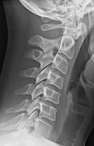
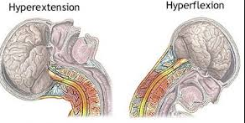
Verletzungsmechanismus

Slide 49
Checklist
Whiplash injury
< Effort, physical-P
< Sitting-P
< Standing-P
< Movement-P
< Turning suffering parts-P
< Upon awaking-P
> Rubbing, massage-P
> Lying-P
Skipping pain
< Cough
Oligomenorrhea
Menstruation too late-P
Menstruation too long-P
Mikturition interupted

Slide 50
Procedure
We repertorize first the polar symptoms of the main complaint:
26 remedies cover all symptoms, 14 without contraindication
Now we add the nonpolar symptoms of the main complaint:
6 Remedies cover everything, 5 without contraindication.

Slide 51


Slide 52
Now we add the menstrual and micturition symptoms:
→ 3 Remedies cover everything, and only Zincum has no contraindication.

Slide 53
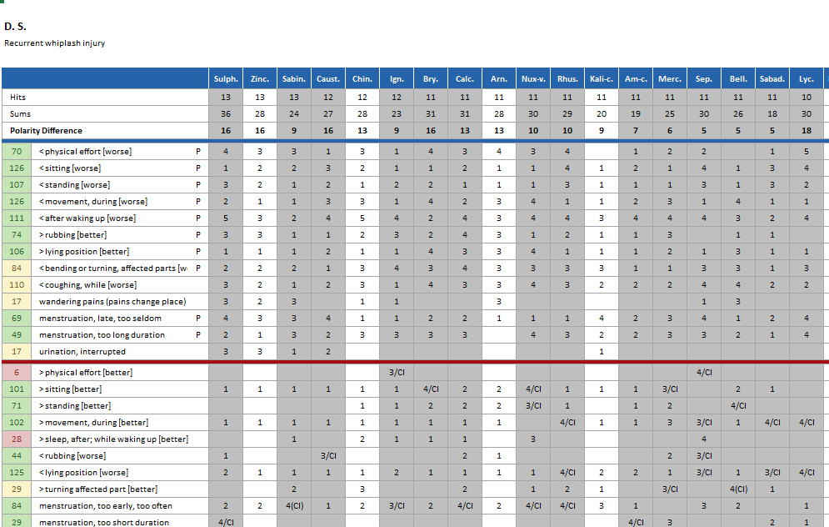

Slide 54
MM-Comparison for Zincum (GS)
Pressing headache upon awaking. Pressure in occiput after walking in open air.
Nape of neck feals weary and tired from writing or any exertion.
Sticking from right to left scapula; constant in margin of left scapula.
Sitches in left axilla and down the forepart of the chest.
Emission of urine very slow and in a thin stream.

Slide 55
Remedy and Progress
Mrs S. receives a dose of Zincum C 200.
The next three days all ailments disappear completely. After a physical effort on the fourth a tingling sensation begins in the left arm, persists for some days and then fades out four weeks.- No more whiplash symptoms since then.
Concerning the menstruation she has six short episodes of bleeding during the first four weeks with black clotted blood and uterine cramps. Then these symptoms disappear too, and a normal menstrual cycle takes place.
No further doses of Zincum. No relapse.
Time of observation: 12 years

Slide 56
Comment
As in the Lennox-syndrome case it is astonishing that a longstanding ailment ends with one single homeopathic dose.
The frequent bleedings might have been a drainage by which the organism gained a new equilibrium.
This case shows how remedy determination is a puzzle in which all parts must fit together.

Slide 57
Fall 5:Ataxic-dyskinetic cerebellar Disease
Mrs L.I. is 44-years old and suffers from a ataxic-diskinetic cerebellar disease, an autosomal-dominant trait in her familiy. Initially she had intervalls of several months between the ataxias, which usually lasted only a few days.
Now they have become a lot more frequent, and between the attacks she does not recover anymore completely.
I see her on the hight of such an attack with massive symptoms: She cannot speak, sees double images, has a wavering gait and uncoordinated movements of arms and hands.
My patient is actually her daughter who suffers of the same disease. But with homeopathy we have reched an improvement of 80%. That’s why I propose to take the mothers’ case as well.

Slide 58
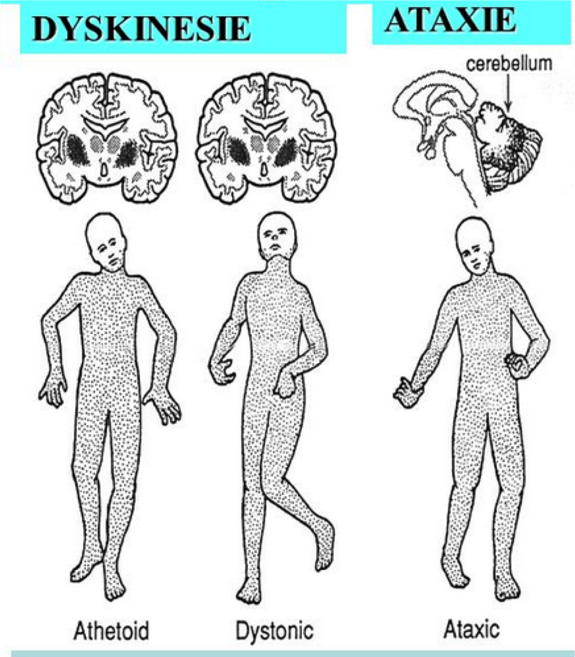

Slide 59
Checklist
Ataxia and Dyskinesia
Wavering, muscle twitching, double images, reduced facial field
Desire for open air-P
< Weather warm-P
< Walking-P
< Physical effort-P
< Rising from bed, after-P
< Swallowing-P
< Speaking-P
> Lying position-P
> Cold in general-P
Kopfschmerzen
< After waking up-P
< Light-P
< Strained vision-P
< Reading-P
> Resting-P
> Lying on back-P
> Cold, when getting cold-P
Tirst-P
Loss of appetite-P
Retention of urine,
Diarrhea

Slide 60
Procedure
We have 18 polar symptoms, rather many…
First we only repertorise the main complaint, the Ataxia, afterwards seperately the headaches.
Then we compare the results and take a remedy that covers both ailments.

Slide 61
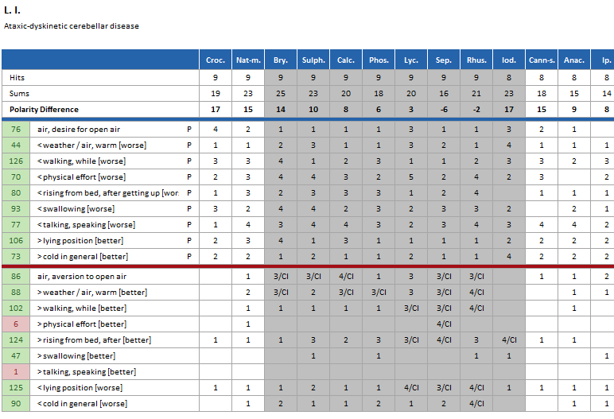

Slide 62
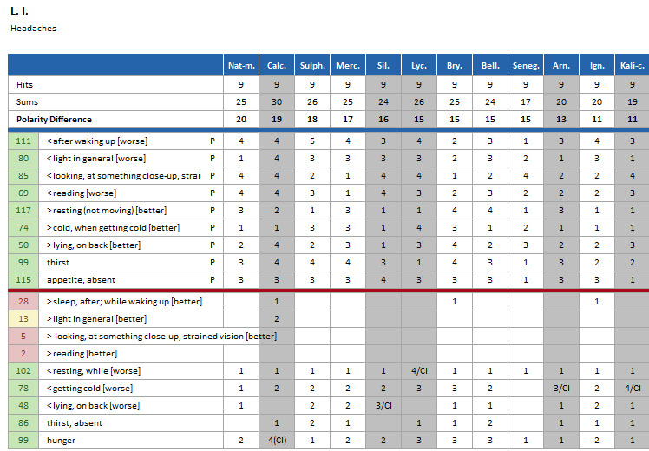

Slide 63
MM-Comparison (GS)
Natrium muriaticum
Crocus
Clumsiness, everything falls out of his hands.
During the attacks nearly incredible movements with arms, head and legs.
Twitching in muscles and limbs.
Twitching in muscles.
Spasmodic contractions of single muscles.

Slide 64


Slide 65
Remedy and Progress
Mrs I. receives a dose of Natrium muriaticum C 200.
The symptoms aggravate for one week, then the ataxias subside, she gets more relaxed for two weeks, afterwards the symptoms increase again. After four weeks improvement is 40%.
We continue with Nat-mur M und XM in 3-week-intervalls.
Under this regime she has a moderate ataxia every fourth day, that last a few hours. The recovery is 60-70% now.
Next try is Nat mur C 200 every fourth day: Nothing changes.

Slide 66
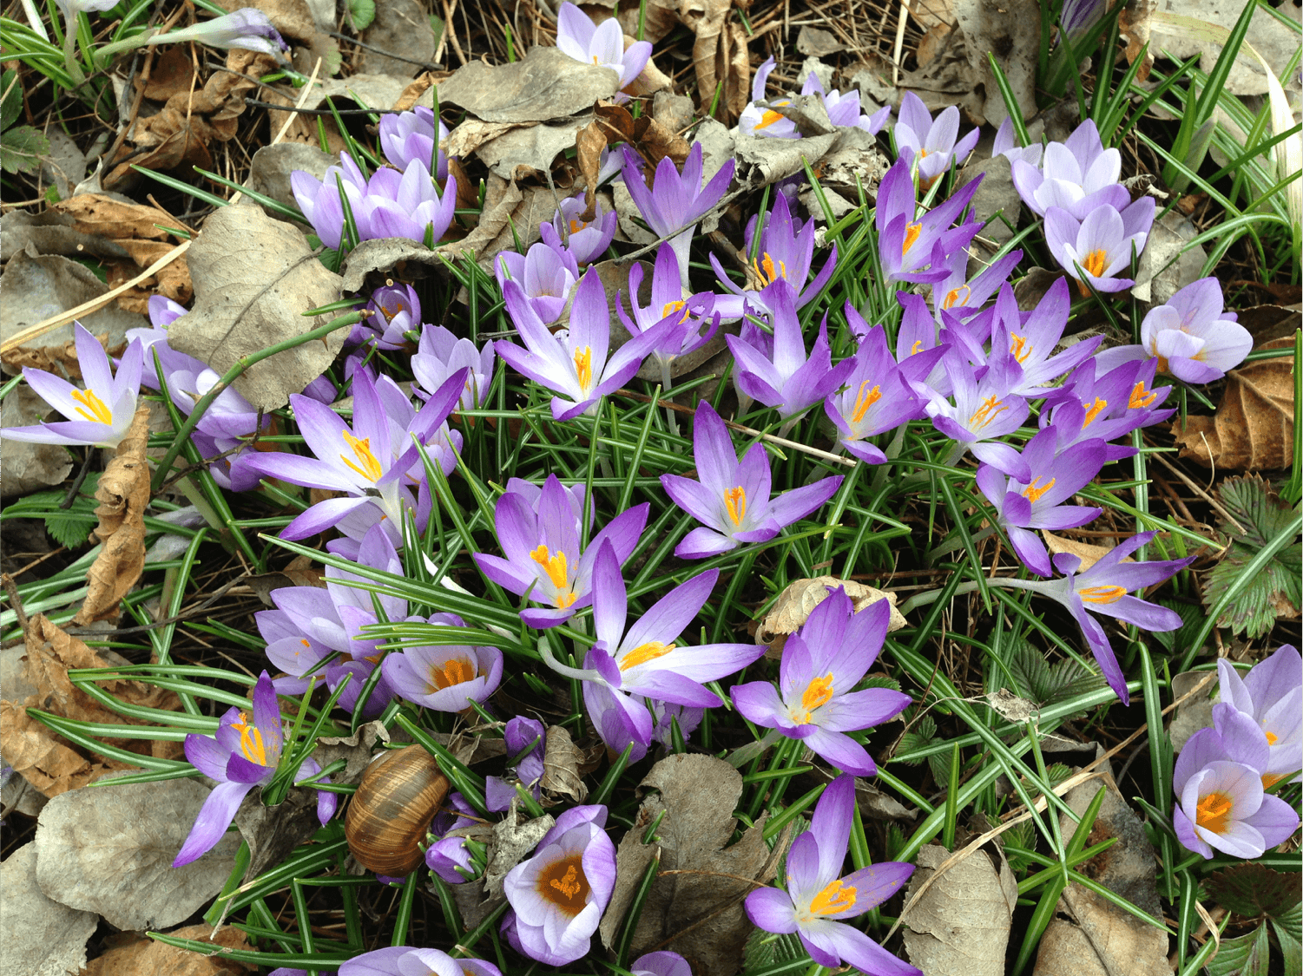

Slide 67
Further Progress
I’m disappointed and switch to Crocus C 200.
Under this remedy she has moderate attacks every 10th day, and her equilibrium improves.
With further doses of Crocus (M, XM, LM, CM) in monthly intervalls she reaches an improvement of 80%.
And we still go on with treatment…

Slide 68
In this case I made two mistakes.
What were they?

Slide 69
I shoud have followed the rank of symptoms of Boenninghausen:
The main symptom has a higher rank than the additional ones.
And I should have paid more attention to the polarity difference in the choice of the remedy.
The Polarity difference is a more important information than the materia medica comparison.

Slide 70
Case 6: Paraparesis of the Legs
Except for frequent tonsillitis, 12-year old Mara has an unremarkable , previous history.
Five days before the consultation she collapses when trying to get up from bed, and is unable to stand up due to a weakness of the legs.
In the pediatric clinic the doctors find a motor weakness and reduced sensibility in both legs. The spine is indolent, cranial nerves and upper extremities normal. And the sensory impairments do not correspond to the innervation segemts.

Slide 71
Diagnosis: Conversion Syndrome
Definition
There is no physical pathology, the patient imitates a physical illness unconciously. This happens mainly in hysterical persons, who cannot distinguish fantasy from reality.

Slide 72
Findings
I see her four days later.
She still has an enormous weakness and cannot walk without help.
The sensibility in both legs is absent, PSR and ASR missing, the Babinsky reflex negativ.
Everything else is normal.

Slide 73
Checklist
Paralytic weakness
Numbness
Muscles, flabbyness-P
Irritability-P
Aversion to movement-P
< Movement-P
< Walking-P
< Standing
< Physical effort-P
< Sleep, before-P
< Rising from bed, after-P
> Rest-P
> Cold in general-P
> Touch-P
> Pressure-P
> Rubbing-P
> Drinking cold water-P
> Cold wrappings-P
< Thinking of ailment-P
< Anger with fear
Hysteria

Slide 74
Procedure
We repertorise only polar physical symptoms, and have a look at the mind symptoms in the materia medica comparison.

Slide 75
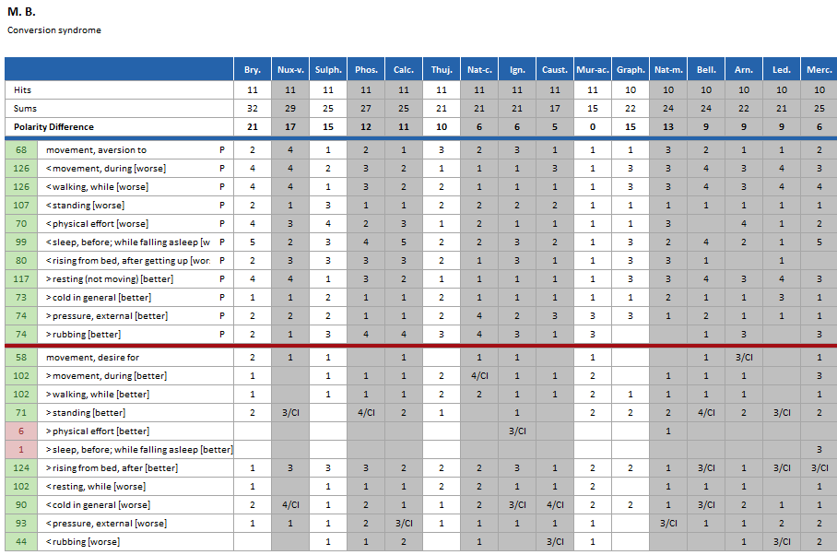

Slide 76
MM-Comparison for Bryonia (GS)
Paralysis, normally on both sides.
The knees waver and buckle when walking.
Great weakness and loss of force, < when walking.
Great lameness and desire to lie still.
Hysterical cramps.
Irritability, anger, fearfulness, morose.

Slide 77
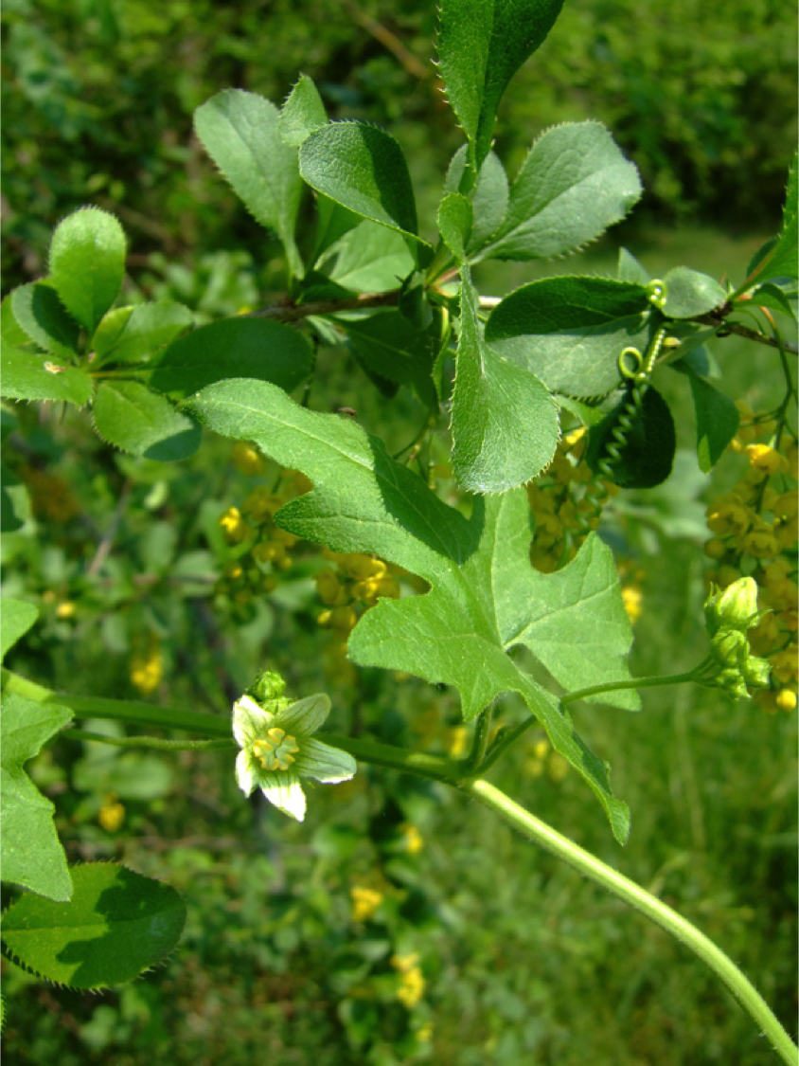

Slide 78
Remedy and Progress
Mara receives a dose of Bryonia C 200.
The first few days nothing changes. After three weeks the sensibility of the legs normalizes from one moment to the next.
The paresis takes longer to recover: After four weeks she still has a moderate weakness.
We give Bryonia M.
The paresis disappears now, and the neurological control after six weeks is normal.

Slide 79
Comment
What was the cause for the conversion syndrome?
Mara felt neglected by parents and older sister who all had intense working phases the weeks before.
Was it a spontaneous cure?
It is intersting that without entering Hysteria in the repertorisation, we get a remedy that covers it, only by using the physical symptoms of this psycho-somatic disease.

Slide 80
Fall 7: Carpal Tunnel Syndrome
42 year old Mrs. Margreth S. suffers since five years from frequent attacks of a carpal tunnel syndrome, with paralytic pain in the hand, weakness when she wants to grab an object and tingling in the arm. Initially Sepia cured the pain, later on she did not react anymore to it. And with Nux vomica we made the same experience.
Now she comes again with violent pain in the right hand joint and the forearm.

Slide 81
Checklist
< Touch-P
< Cold in general-P
< Weather cold-P
< Cold, when getting cold-P
< Bending affected limb-P
< Lying on painful side-P
> Warmly from wrapping up-P
Movement, desire for-P
< Weather changes
Drawing, bruised, beating, paralytic pain
Sensitivity of periostum
Tingling
Weakness of joint

Slide 82
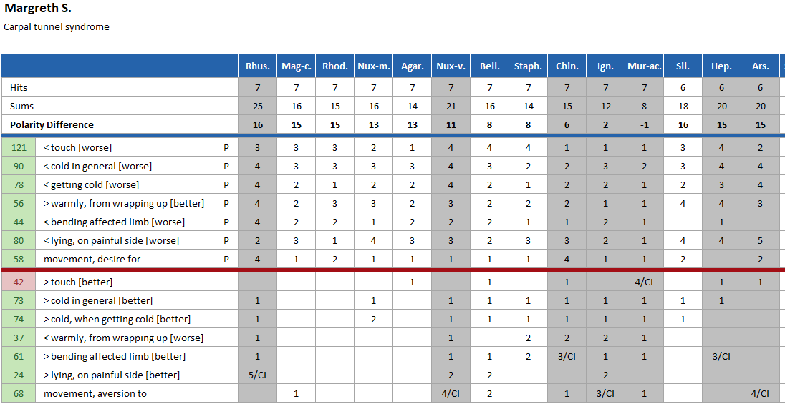

Slide 83
Interpretation
Eleven remedies cover all symptoms, five of them are discharged because of contraindications.
The interesting remedies are Magnesium carbonicum, Rhododendron, Nux-moschata und Agaricus.

Slide 84
What is the value of the sensations?
Drawing, bruised, beating, paralytic pain
Sensitivity of periostum, Tingling

Slide 85


Slide 86
Effect of Sensations
Without sensations we have four favorite remedies.
With the sensations the differential diagnosis gets unclear,
but favors Magnesium carb.
The other remedies we had before fade into the background.

Slide 87
Materia medica-Comparison (GS)
Magnesium carbonicum
Rhododendron
(Nothing, that correspond to the patients symptoms).
Pain as if sprained in right wrist joint, < when at rest and in rough weather.

Slide 88
Materia medica-Comparison (GS)
Nux moschata
Agaricus
Numbness and fullness of hands, in evening, trembling and weakness of hands.
Tearing in upper arm.
Burning sore pain in skin of right hand from wrist to thumb and index finger. Slightes touch with finger is painful.
Right hand unsteady while writing. Arm feels paralyzed from much writing.
Left hand up to forearm asleep at night in bed.

Slide 89
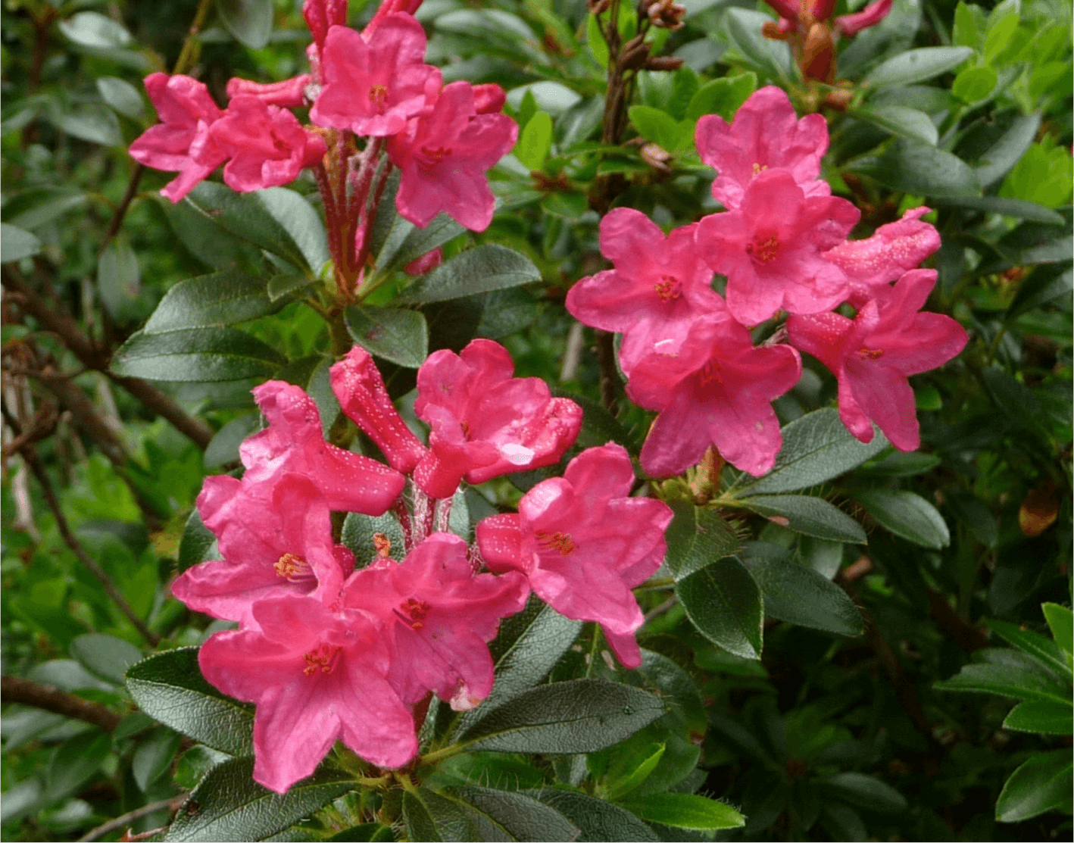

Slide 90
Remedy and Progress
I decide for Rhododendron C 200, who’s genius seems to fit to the patients symptoms. And Mrs. S. receives a wrist-splint for the night.
After three weeks she reports to have no pain as long as she does not work, but with work the pain returns. She receives now a dose of Agaricus C 200.

Slide 91
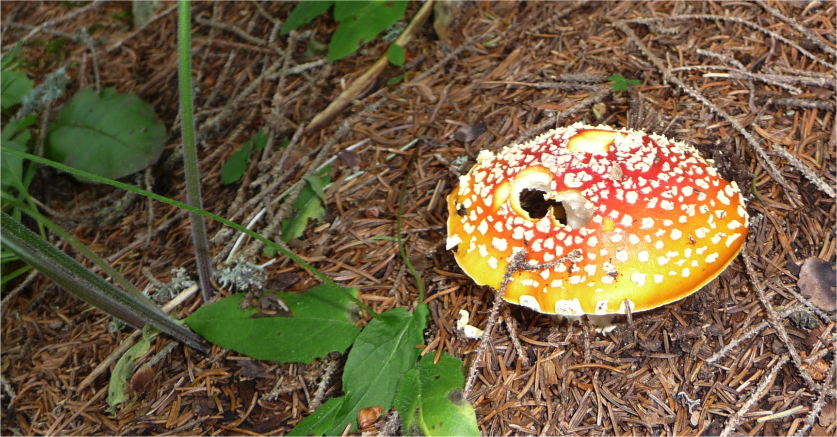

Slide 92
Further Progress
Within 24 hours the wrist pain disappears and she resumes her work.
After three weeks she rates the improvement with 100 %. This lasts 18 months; then she has a slight relapse, which disappears immediately after Agaricus M.
Since then she has no problems with her carpal tunnel.
Observation time: 10 years.

Slide 93
Comment
The case shows how sensations can obscure a repertorisation. Due to such experiences we have defined reliability criteria for symptoms.
It also shows what happens, when we have a prejudice due to the «picture of a remedy» stored in our brain…

Slide 94
Case 8: Trigeminus-Neuralgia
Mr. Michael G., 73 years old, comes to our practice with frequent attacks of violent pain in the left jaw and cheek, each one of about 30 seconds duration. They are accompanied by jerks over the left side of the face.
In addition he has nosebleeding and feels extrasystoles. Due to a previous heart attack and a deep vein thrombosis he takes an anticoagulant. Now he is afraid that to have something serious.

Slide 95
Checklist
Trigeminus Neuralgia
Oppressive pain
Jerks
< Draft
< During sleep-P
< Cold in general-P
< Cold, becoming cold-P
< Touch-P
< Pressure-P
> Warmly from wrapping up-P
> Lying on painful side-P
Additional symptoms
Nosebleeding
Extrasystoles (irregular pulse)

Slide 96
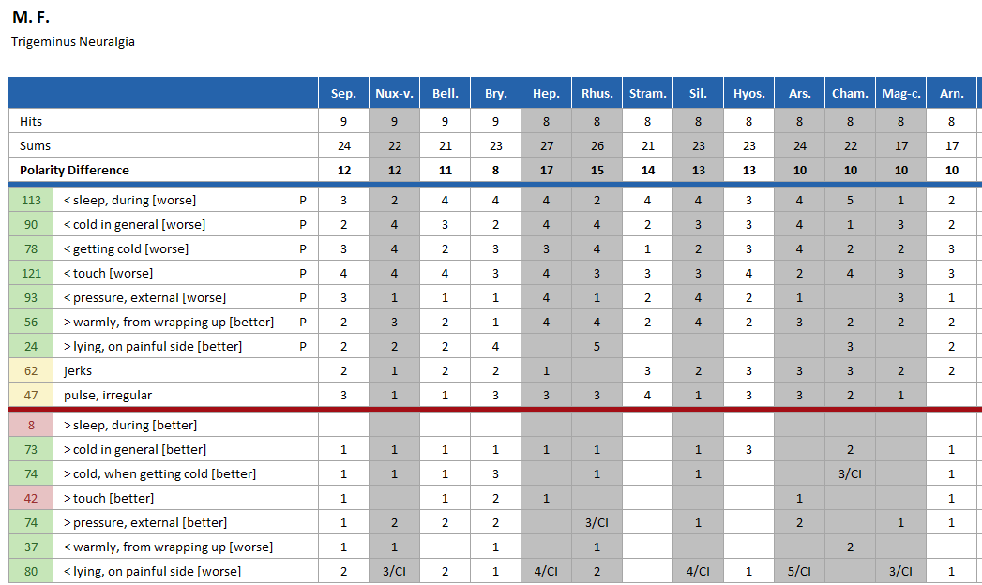

Slide 97
MM-Comparison (GS)
Belladonna
Sepia
Paroxysms of facial neuralgia brought out by riding in wind and from exitement, > from pressure, beeing in a warm room and lying quiet.
Neuralgic pains begin in left temple and runn over left side of face and jaw.
Jerking muscles of face when talking.
Neuralgic pains commencing under left orbit and running back to ear, < from touch and motion.
Twitching of facial muscles.

Slide 98
Which remedy corresponds in his genius most probably to the patients symptoms?

Slide 99
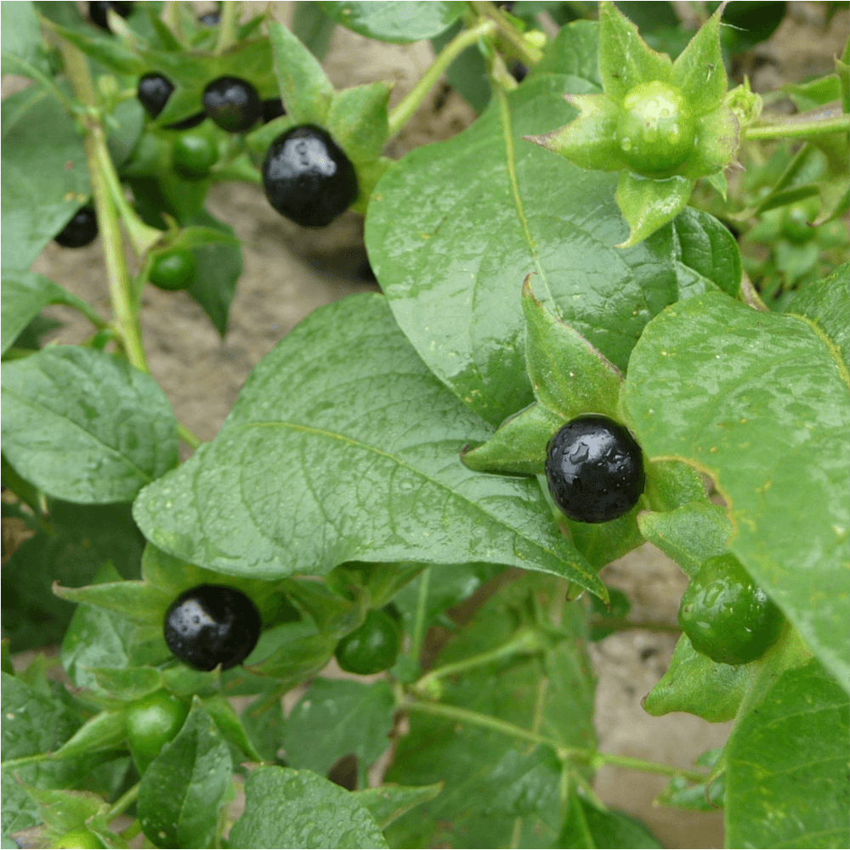

Slide 100
Mittelgabe und Verlauf
Mr. F. receives one dose of Belladonna C 200.
The next day he calls to tell us he had a good night.
The same thing happens a day later: The neuralgic pain and the extrasystoles have disappeared, and in the long run his trigeminus nerve keeps quiet.
Time of observation: 10 years.

Slide 101
Comment
The similarity to the Lennox case is apparent: In both patients a convulsive disease disappears with one dose of Belladonna.
Belladonna actually is supposed to be a right sided remedy. This case as well as our longtime experience show, that the lateralities are not a reliable criterion.

Slide 102
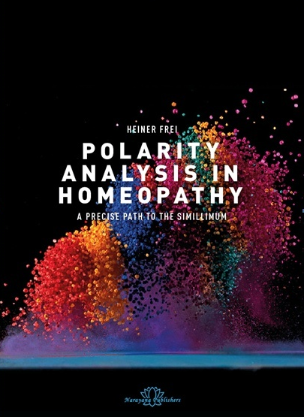
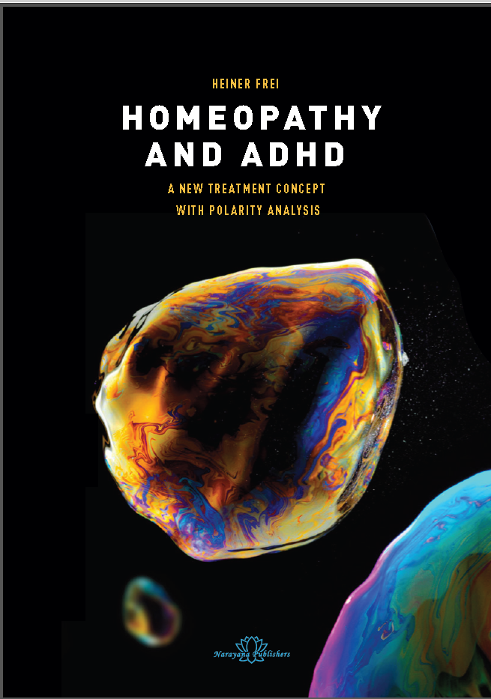
Further Literature
www.heinerfrei.ch
https://polarity-analysis.com

Slide 103
Thank you for your attention!

